Slide 1
Did you know your firm has a crypto trading platform?
Ramp and Dump Schemes to Executive Assassinations/Cyber Stalking

Slide 2
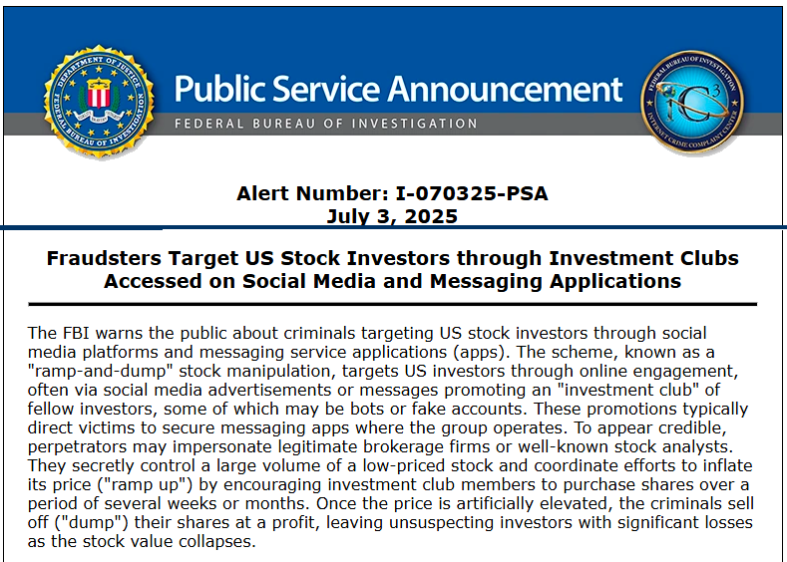
FBI PSA
I-070325-PSA
Investment Clubs
Crypto
Social Media

Slide 3
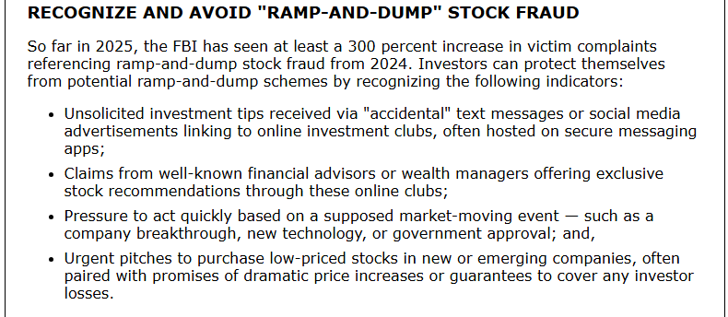
FBI PSA
I-070325-PSA
Investment Clubs
Crypto
Social Media

Slide 4

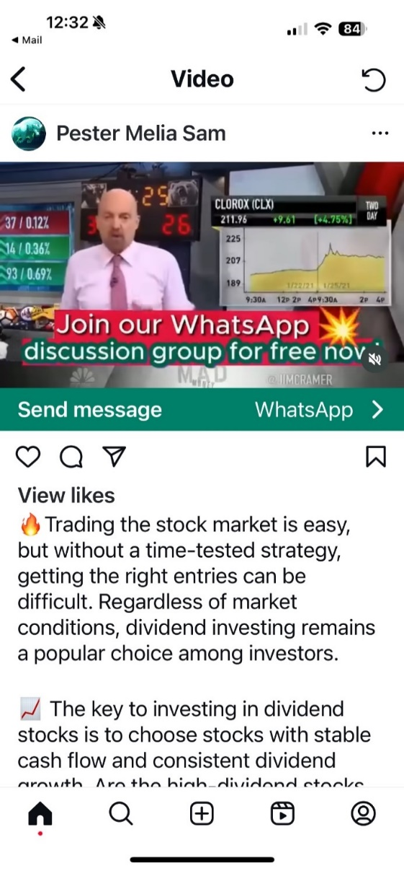
Scheme starts with Social Media

Slide 5
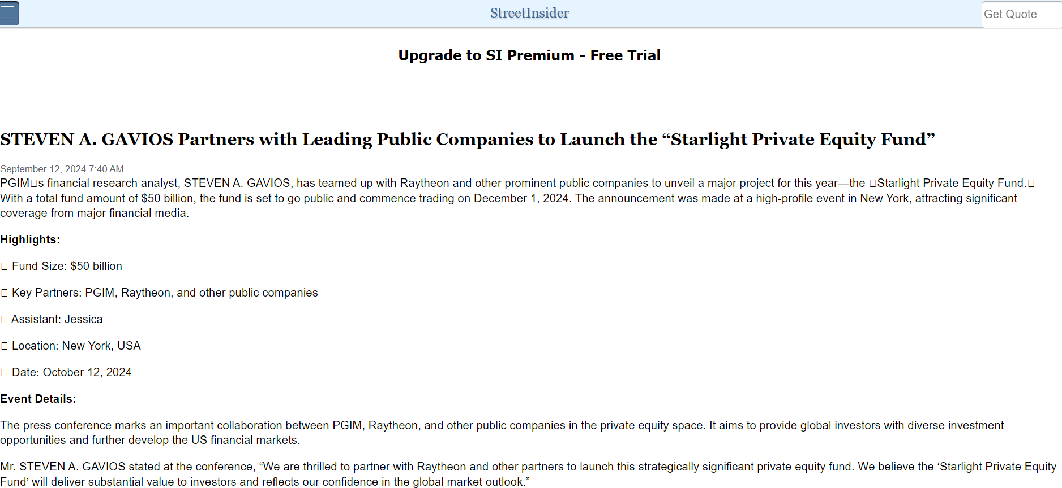
Or Official Websites

Slide 6
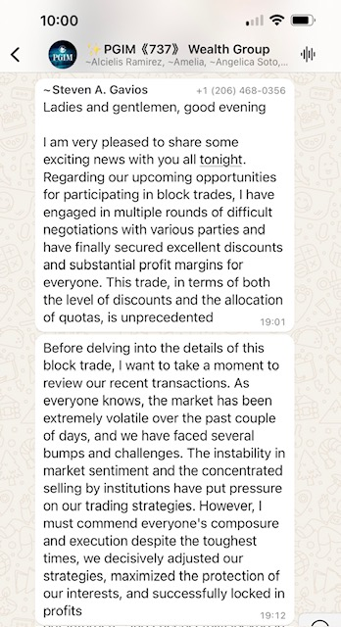

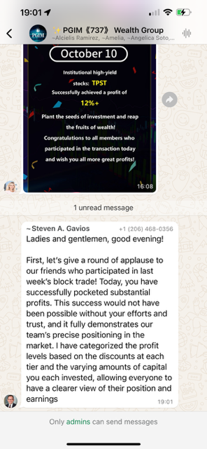
Impersonation of Your Employees

Slide 7

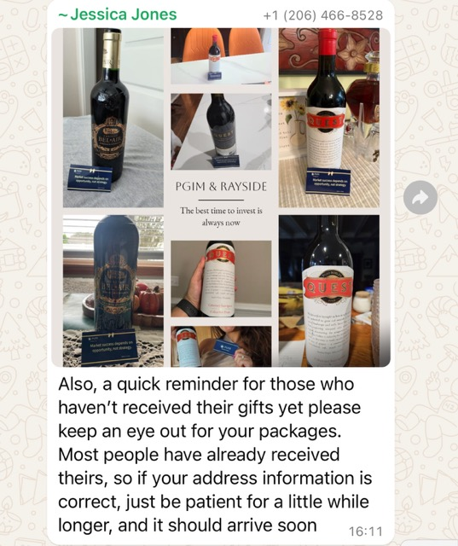
Enticements to keep investing

Slide 8
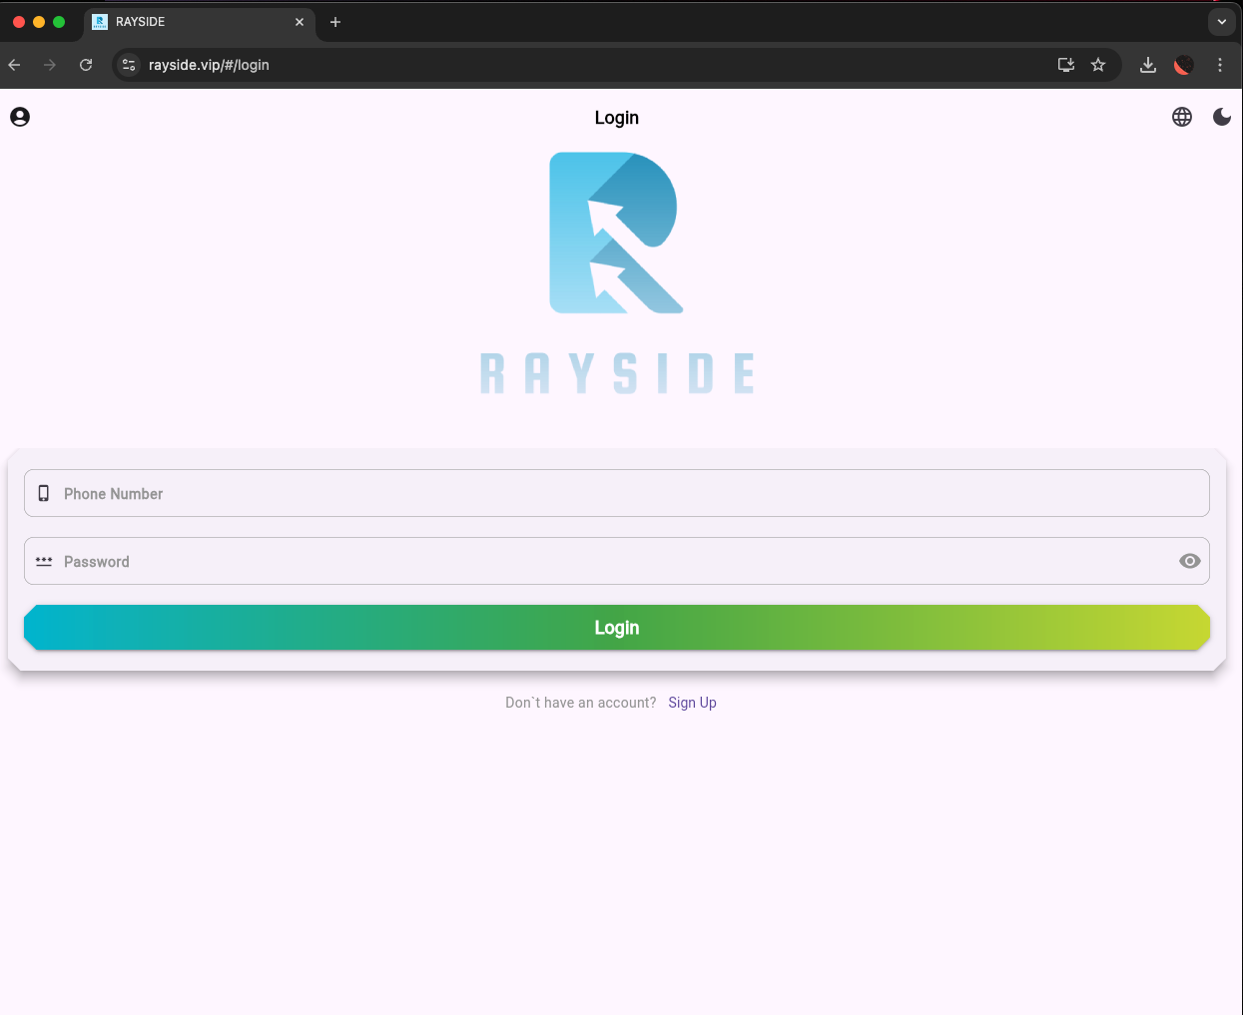
On-line Trading Platform with Security

Slide 9
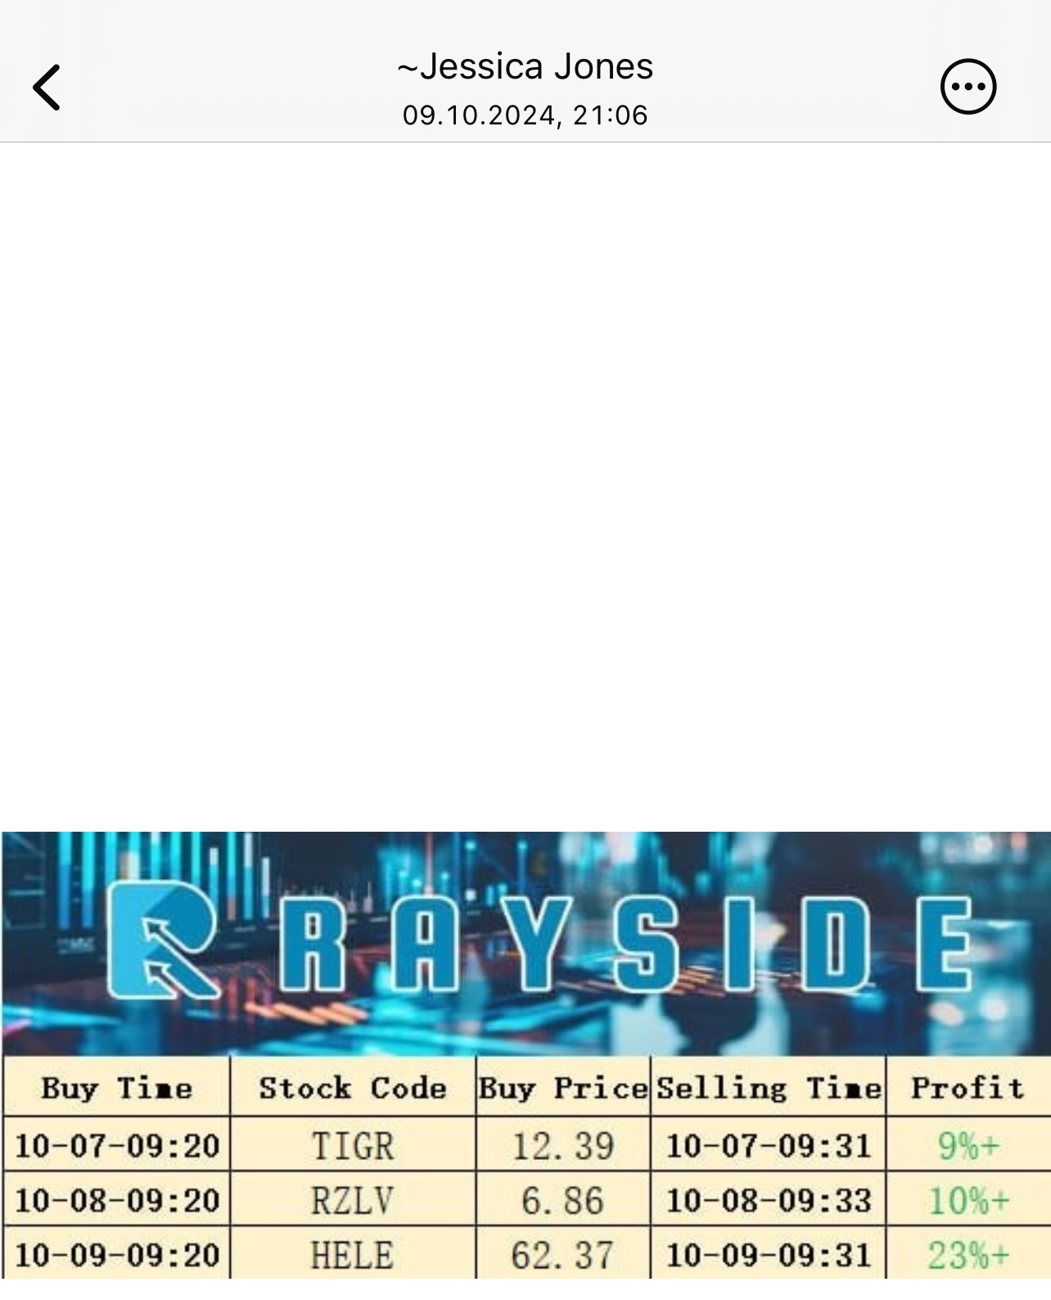
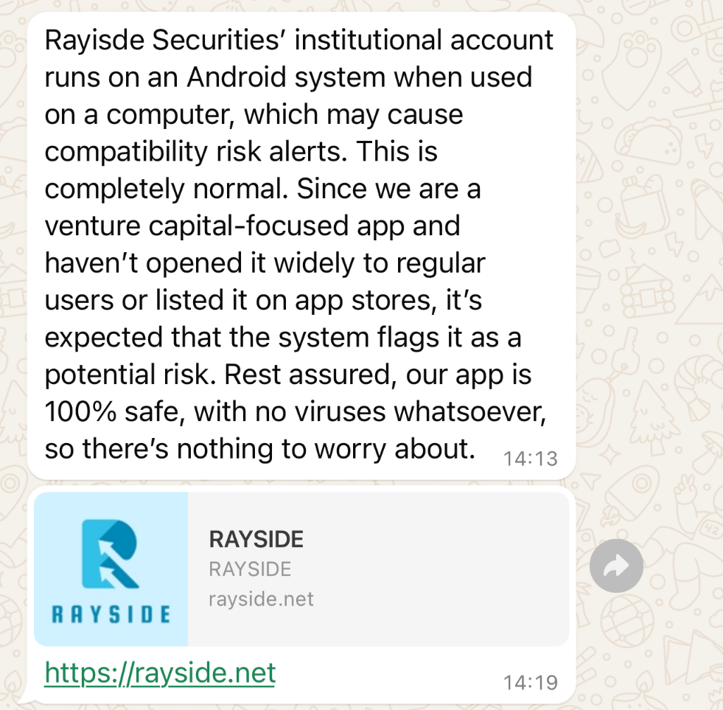
Online Trading Platform

Slide 10

Executive Protection

Slide 11

Executive Protection

Slide 12

Executive Protection
Shane Daley

Slide 13
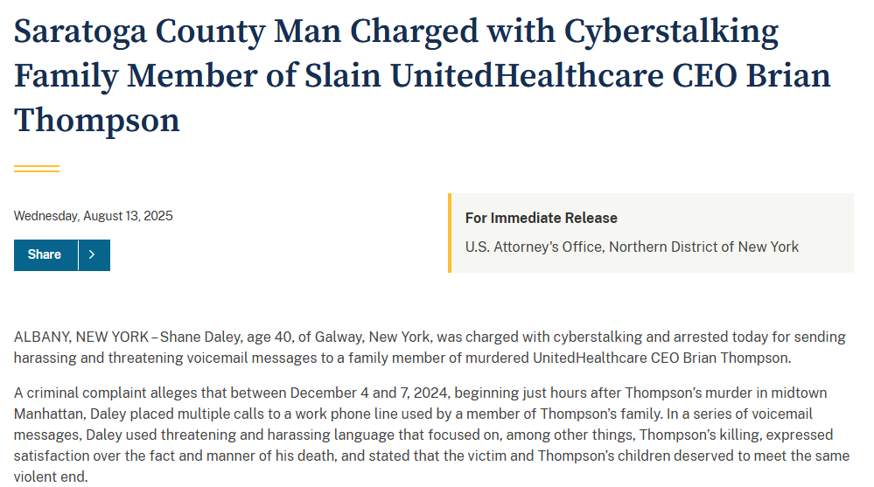
Executive Protection

