Slide 1
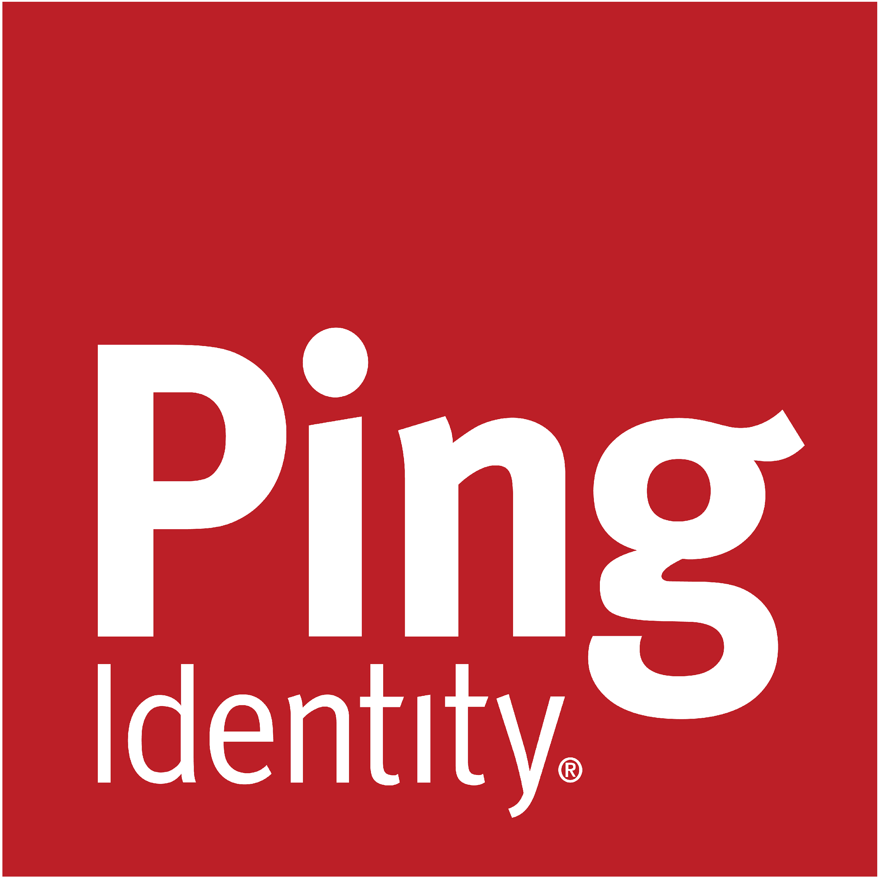
Securely Embrace
the Agentic Channel
Darryl Jones - VP of Product at Ping Identity
Notes:
Good morning everyone it has great to be here in New Jersey.
My Name is Darryl Jones, I lead the Consumer Identity Segment here at Ping Identity.
Responsible for strategy and roadmap and investments in customer identity at Ping.
Today we are going to focus the new and emerging Agentic Channel and how this is both an opportunity and a threat for organizations.
We will talk about the types of agents and how both customer experience and the internet itself its evolving due to the emergence of agentic channel.
We will also talk about some best practices.

Slide 2
Your next multi-million dollar customer may be an AI agent acting on behalf of a customer.
Notes:
We have been in a very rapid evolution of AI Based technology since the break through of chat GTP in 2022, and then the arrival of chat GTP Operator and others in early 2025.
Subsequently we have had announcements around ACP - agent commerce protocol, UCP, TAP and others that handle Agent AI to Merchant interactions.
Make no mistake about it, we are moving into a world where consumers are being represented by their AI Agents, or AI agents acting on their behalf like chat GTP Operator.
In this world, consumers can add a layer of intelligence and ease of use to their experiences and save time.
And in this future your next multi million dollar customer - may actually be an AI agent, acting on behalf of a consumer.

Slide 3
The Rise of Agentic AI
$47.1B
The agentic AI market is
projected to scale fast, essentially
doubling every two years.
Agentic AI was valued at $5.1B in 2024.
$5.1B
The market is projected to reach $47.7B by 2030.
2024
2030
Notes:
The emergence of the Agentic AI market is poised to grow quickly.
And its scale magnitude may be larger than the historical arrival of ecommerce itself.
Essentially doubling in value every 2 years.
When we look at this from a search standpoint - LLM’s are already having an impact on search volumes.
Adoption is happening rapidly now, and it is going to continue to accelerate.
This has significant implications for both business and technology.
—-------
Source: https://www.mordorintelligence.com/industry-reports/agentic-ai-market

Slide 4



New
Channel
New NHI
CRM
Human Ownership
Agentic CX/Tracking
Commerce
Risk
Governance
Your next multimillion- dollar customer might be an agent acting on behalf of a user
Agents are another
form of NHI requiring strong controls to limit security risk
Human-in-the-Loop
AuthZ
Notes:
There are two sides to every coin.
AI Agents applied to Commerce are about the emergence of a new channel, about new ways to manage and maintain relationships with customers.
It’s also about agentic experience and the decisions agents will make based on inputs from you, to determine if they make a purchase from you or someone else.
On the other side, there is Risk. Understanding who is liable, governing agents, authorizing them carefully are all important.

Slide 5



AI Agents need access to data and services
Authentication, Authorization and Approvals
MCP
Delegation
A2A
USER
AGENT
APIs
Unique Agent Identity
DBs
AGENTs
WEBSITEs
To get ‘smart’, AI Agents need to integrate with APIs and Services.
This interactivity means that IAM is central to AI Agent success.
Notes:
To get smart, AI Agents need interactivity.
There are a number of immediate identity related challenges
How does a user appropriately delegate their permissions to an agent?
How does we represent an agent identity in our IAM systems?
How do we handle authentication and authorization of this agent against different forms of services; primarily APIs, but they could be interacting with a range of things: DBs, websites, other agents
When we’re delegating authority to these agents, how do we introduce approvals mechanisms to ensure that humans are appropriately involved for sensitive actions.
And I’m not going into details here, but you’re going to hear about things like MCP - Model Context Protocol - and A2A - Agent to Agent - which are standardizing how agents can interact with services.

Slide 6




Classifying Agents
Ownership
Interaction
Supervision
Identity
Managed Agent
operated by the enterprise
Personal Agent
bring your own
API
(including MCP)
Web GUI
(CUA)
Supervised
Semi-Supervised
Unsupervised
Autonomous
with own account
On Behalf Of
a user
Notes:
Ping as well as the industry as a whole is working on paradigms to understand the boundaries in which these agents are acting in order to help define the use cases where identity and security controls can be put in place.
Some of those boundaries include:
How to handle ownership, whether the enterprise is deploying and operating the agent or the user is bringing their own.
How to address when an agent is interacting directly via APIs and MCP servers or a computer-using-agent interacting through a computer’s web browser as an example.
How the authentication and authorization is handled when a user is guiding and supervising the agent or when the agent is acting on its own.
How to manage and gain visibility of the identities of agents and their relationships with users.

Slide 7



Introducing AI Agents
Personal Agents
Digital Assistants
Digital Workers
“Your agent works for you”
“Our agent works for you”
“Our agent solves tasks autonomously”
PERSONAL AGENT
MANAGED AGENTS
Notes:
At ping, we break down the types of agents into 3 major categories.
The personal agent, especially within the context of consumer facing use cases, is really a new channel that can provide tremendous opportunities for a company.
The user may be leveraging a shopping agent, a travel agent, or an investment agent that the enterprise doesn’t manage and is bringing the intent and preferences of the user to the door.
This lack of control drives some specific problems that need to be addressed.
This is akin to enterprises not being able to control what mobile device, operating system, or browser that is being used to interact with them.
Digital assistants can be thought of as a sort of front-line worker that is managed by the enterprise.
They can be both customer facing and deployed for the workforce.
They are often within the context of a chat or dialogue type of interface embedded in a website or application.
They are mostly acting on behalf of a user.
We find that many organizations are creating and deploying these digital assistants embedded within their products to assist their end users to drive more successful outcomes and engagement.
These digital assistants are accessing underlying systems more and more with or without all the controls in place.
Digital workers are more autonomous, which doesn’t mean they are not interacting with users, but will require their own sets privileges.
Enterprises are looking to understand how to manage the lifecycle of an agent, monitor which agents are deployed, how they are acting, and govern what they have access to.

Slide 8
Agents in the Consumer World
Personal Agents
Digital Assistants
Digital Workers
“Your agent works for you”
“Our agent works for you”
“Our agent solves tasks autonomously”
PERSONAL AGENT
MANAGED AGENTS
Notes:
There are two primary types of agents in a consumer world.
Personal Agents that might be Chat GTP Operator for example, and Customer Facing Agents like digital assistants - that might operate on a customers behalf fueled by an LLM and empowered to act on the back end via MCP for example.
Today we will focus on these two types of agents and their interactions from an identity standpoint.

Slide 9




The UI of the Internet is Changing
Search Engines
Answer Engines
Outcome Engines
Find
Know
Do
Digging Through Results
Direct
Responses
Intent Leads
Directly to Action
Notes:
These consumer facing and personal agents are shifting the UI of the internet.
The UI of the internet is changing by shifting from static, human-navigated pages toward dynamic, AI-powered, and immersive experiences.
Artificial intelligence is driving these changes, making interfaces more conversational, personalized, and seamlessly integrated.
Historically users would search based on terms and dig through results of human created content.
This has now moved to answer engines - where information is searched and considensed and summarized by LLM’s with much more precision.
And its changing the ways users interact - they can now be much more specific about what exactly they are looking for, and get much more precise results.
Now, we are moving towards Outcome Engines - where intent leads directly to action.
For example, I am searching for a vacation destination, but what is my real end goal? My real goal is to book a vacation of my dreams as seamlessly and as easily as possible.
And this is the part that Agentic ultimately enables and where the internet is moving towards.

Slide 10







Agents Set to Revolutionize Cx
Fragmented Channels and Tools = Friction
A not so hypothetical vacation journey…
Inspiration
Research
Purchase
Check-in
Travel
Stay
Review
Remember
Agentic Channel
Notes:
So let’s dissect this vacation journey example a little further as it relates to customer experience.
When we take a step back, all the efforts to improve experience have largely been done within corporate silo’s.
What I mean by that is that each organization, is optimizing their own customer experience within their own channels.
If I only had to work with one organization as a consumer, that would be fantastic.
But the reality is that to complete any 1 customer journey - let’s say the one here on screen you need to interact across many apps, and many channels within those apps.
Lets talk through this example. The first phase of my vacation travel journey Is inspiration.
I may gain inspiration for my trip from friends on say youtube, instagram, pintrest, etc. Each with their own authentication and experience.
Next I research my trip. Maybe I use google, trip advisor, travel blogs etc.
Then I start to shop - using Expedia, Air BnB,
Then I begin to prepare for my trip - maybe it’s lounge access apps, maybe it’s my airline app.
Then I take my trip, check into my hotel with my hotel app, then I review the trip on trip advisor, and I share photos from it with my friends an family.
You get the point - you are working across many many different apps here.
The issue gets more complicated with each channel the apps use.
For example - website, email, app, sms, even brick and mortar.
In the identity world, I am often jumping across channels maybe for an MFA, switching between my mobile device and my laptop.
So in the end the proliferation of apps from many organizations, and complex use of channels across organizations, has led to an erosion of customer experience, and unwanted friction.
But it also poses a generational opportunity for improvement.

Slide 11

A New Channel Emerges
Consumers will drive the emergence of a new channel to solve the multiple channel, multiple app challenge. Enter Agentic Commerce.
The 5th Channel
Company A, B, C, D…
Website
Email
Website
Email
Website
Email
Website
Email
App
Messages
App
Messages
App
Messages
App
Messages
Notes:
Agentic AI will redefine the omnichannel experience by adding a new 5th channel.
And for the reasons we just discussed - collapsing other channels where appropriate, and the ability to get things done across apps and organizations and ultimately saving customers time and money - customers themselves will drive the emergence of this new channel.
That is not to say that the existing channels that we know and love will disappear - they will not.
But we do have a new channel, that has a new set of rules, that customers are beginning to adopt.
And we need to consider how this extends the omnichannel experience and also the new types of interactions that will evolve.

Slide 12




A New Opportunity to Optimize Experience…
These 4 Interactions will begin to co-exist. The choice of which interaction is the best fit will be driven by optimal CX.
Identity 1 | Interacts with Identity 2 | Interaction
Personal Agent (Acting on Customer’s Behalf) | Digital Assistant | Agent <> Agent
Personal Agent (Acting on Customer’s Behalf) | Enterprise Human | Personal Agent <> Enterprise Human
End Customer | Digital Assistant | End Customer <> Enterprise Agent
End Customer | Enterprise Human | End Customer <> Enterprise Human
Trust in these interactions won’t exist without Identity!
Notes:
Let’s focus for a moment on some of the new interactions that are emerging.
The agentic channel comes with a new opportunity rebalance and optimize customer experience.
Personal Agents will interact with digital assistants like chatbots - in order to get things done. This is where we use protocols like A2A or Agent to Agent.
Personal Agents may also need to interact with enterprise human support as an escalation path, if they cannot get things done with the digital assistant.
And of course end customers will continue to interact with digital assistants and humans.
Now though, we have a new opportunity to optimize experience across these interactions.
For example - end customers may prefer to use a personal agents for certain activities, but they may still prefer a human interaction for others.
The choice of which interaction makes the most sense is driven by the optimal customer experience across their journey.
And as in any other area where value is transacted - you need to understand the identity on both sides in order to trust those transactions.

Slide 13
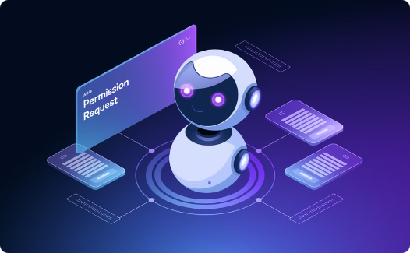
…and Organizational Value
Personal AI Agents pose a threat of disintermediation.
And an even larger opportunity for automated business growth.
Take advantage of a new channel of commerce disrupting existing channels.
Improve CX by accepting customer AI agents and respecting their choices.
Maintain and expand relationships with customers vs being disintermediated.
Notes:
We have talked a lot so far about how this revolution makes the end customers life easier.
But what opportunities and threats does it pose for organizations.
For one, we can improve customer experience by meeting customers where they are as they adopt the use of agents.
You can differentiate by providing agents and users a safe, secure and frictionless experience.
But Personal Agents do pose a threat of brand disintermediation.
If it’s only the agent that that a brand is interacting with - the brand my never get the opportunity to create a long term relationship with the ultimate human budget holder.
However, by understanding establishing a relationship between a personal agents identity and its human owners identity you can bridge that gap.
Brands are going to need to work even harder to establish ongoing relationships with human consumers, across the all the channels the customer are using.
At the same time, agents are going to bring organizations new customers that may have never found them otherwise.
For example, maybe the perfect product was on page 500 of a google search, now through an agent its #1, and a new customer is acquired.
On the other side of the coin, with Agentic Chat Bots acting autonomously for example, you can achieve efficiency in customer service that were not possible before.
These enterprise agents are acting on behalf of your customers, but within your corporate boundary to get things done for your customers and access to services that only humans could before.
The long story short here is that many organizations are already down this path both on the chatbot side as well as the personal agent side, and those that get there faster are going to have a competitive advantage in the market.

Slide 14

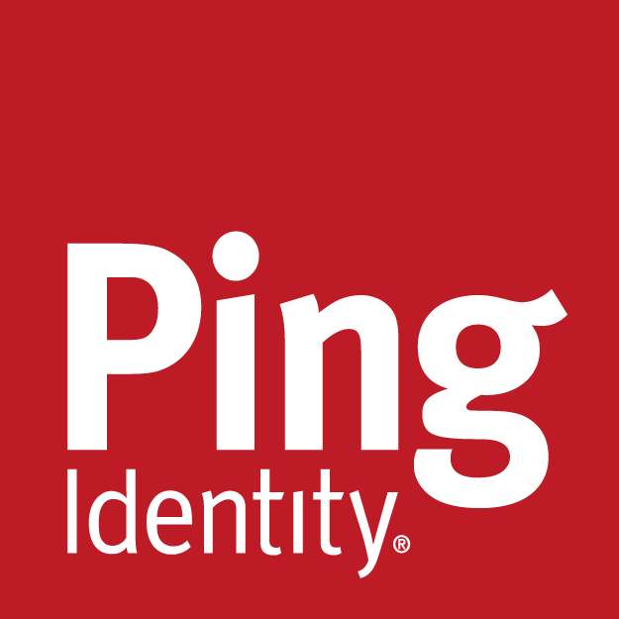
Ping’s Approach
Enable
Secure
Notes:
Lets transition now to talk about Pings Approach to the Agentic space and channel.
We believe the goal is to both enable and secure agents cross the identity lifecycle.

Slide 15




Every Stage of the Agent Journey Requires Identity
IDENTIFY
AUTHENTICATE
AUTHORIZE
PRIVILEGE /
GOVERN
Unknown
Known
Trusted
Authorized
Certified
‹#›
Notes:
When we think about identity for AI and the requirements from feature function perspective, you're going to see some very familiar words.
Identify, recognize, onboard, register, authenticate, authorize, life cycle, manage, govern, monitor.
Sounds really familiar because it is.
In fact when you think about AI agents, they're just another identity type, just like a workforce identity or an employee identity, just like a customer identity, just like a partner identity.
It's just another type of identity with some unique aspects that we need to manage.
And so many of the same principles that we've used historically for human identity also apply to agents as does the functionality.

Slide 16





Best Practices Identity for AI
Recognize Agents
Identify Agents
Use Delegation, Not Impersonation
Authorize Agents Carefully
Verify Humans for Sensitive Actions
Identify when session is agentic
Provide indicators & mark agentic sessions so apps can adjust experience
Provision agents with identifiers
Establish Relationship with Human User
Ensure credentials are not shared with agents
Verify approval with MFA or out of band flow
Enforce controls (least-privilege, step-up authentication)
Use short-lived tokens to reduce risk
Prompt human for sensitive operations
Log these verifications for audit purposes
Notes:
As we begin to move into the agentic future, there are some items from an identity standpoint that we need to keep in mind.
To start, we need to be able to recognize agents.
We need to know when an agent is at our door, vs a human because they require different treatment.
And we need to be able to classify the type of agent - is it a personal agent or digital assistant or digital worker because they require different treatment.
We also, importantly, need to be able to tell the difference between a bot and an agent.
We also need to be able to provide agents with identities, and establish a relationship with their human user.
It’s important to use delegation and not impersonation for agent access.
So for example an agent shouldn't be leveraging a user's credentials to log in to things directly.
We need to make sure that it either has its own credentials or it’s acting on behalf of a user.
Otherwise it can be dangerous from a security, monitoring and logging standpoint.
Authorization of agent activity is critical to enforce least privilege scoping down what an agent can do, and what it can access.
This might be accomplished through OAuth consent where the end user can decide the entitlements to delegate to an agent
Or it might be through just in time governance where an agent is granted a certain set of entitlements and when it needs more it might request more from its supervisor.
Different agents will have different permissions and consents based on their human owners preferences, or what they are allowed to do within the corporate boundary.
And finally, they should reach out to their human owners for consent and approval for certain tasks like a high value transaction.
All of agent behavior and relationship with human needs to be logged and auditable
First of all, you have to know your agents. You have to be able to identify and classify them.
People keep mixing and matching between the notion of personal agents and digital assistants.
It's really important that we can differentiate what we're dealing with because you have to handle them in different ways.
For managed agents inside the organization, they should be assigned supervisors or sponsors that govern what they do and what they can access.
You can think of this a bit like a supervisor and an intern. We have to ensure that the intern has access to the right things.
Detecting agents is important. We need to be able to identify when a session is agentic.
We need to use delegation and not impersonation when an agent accesses things.
So for example an agent shouldn't be leveraging a user's credentials to log in to things directly.
We need to make sure that it either has its own credentials or it’s acting on behalf of a user.
We need to Enforce least privilege, scoping down what that agent can do and what what it can access.
This might be through OAuth consent where the end user can decide the entitlements to delegate to an agent
Or it might be through just in time governance where an agent is granted a certain set of entitlements and when it needs more it might request more from its supervisor.
Then lastly, human in the loop. This is a way of ensuring that a human is notified if the agent plans to do a sensitive operation and ensures it asks for permission to proceed.

Slide 17

Identity for AI
Identify/Recognize
AuthN/AuthZ
Good vs bad bots
Human-in-the-loop
Onboard/Register
Govern
Identified/associated
with a human
Human ownership,
confirm permissions
Lifecycle Manage
Monitor
Enterprise management and customer self-service
Auditable and analytics
Notes:
To sum it up, if we take as step back, the phases of the agent identity journey can be related to the customer journey.
We need to identity and recognize agents so we can give them proper treatment.
We need to on board and register the agent along with their human association.
Manage their lifecycle, Authenticate and authorize then, govern them and monitor.

Slide 18



Identity for AI Vision
Engage the
Agentic
Channel
Recognize agents, relate them to humans, and deploy agents to serve customers
Secure the
Autonomous
Workforce
Discover, lifecycle manage, secure, and govern
Protect against
Adversarial
AI
Protect against deepfakes and AI-based attacks
Notes:
And finally to summarize, we have been focused more on the agentic channel in this presentation, but we at ping are over all focused these 3 key areas .
Agentic channel, Autonomous Workforce and helping to project against adversarial AI.

Slide 19
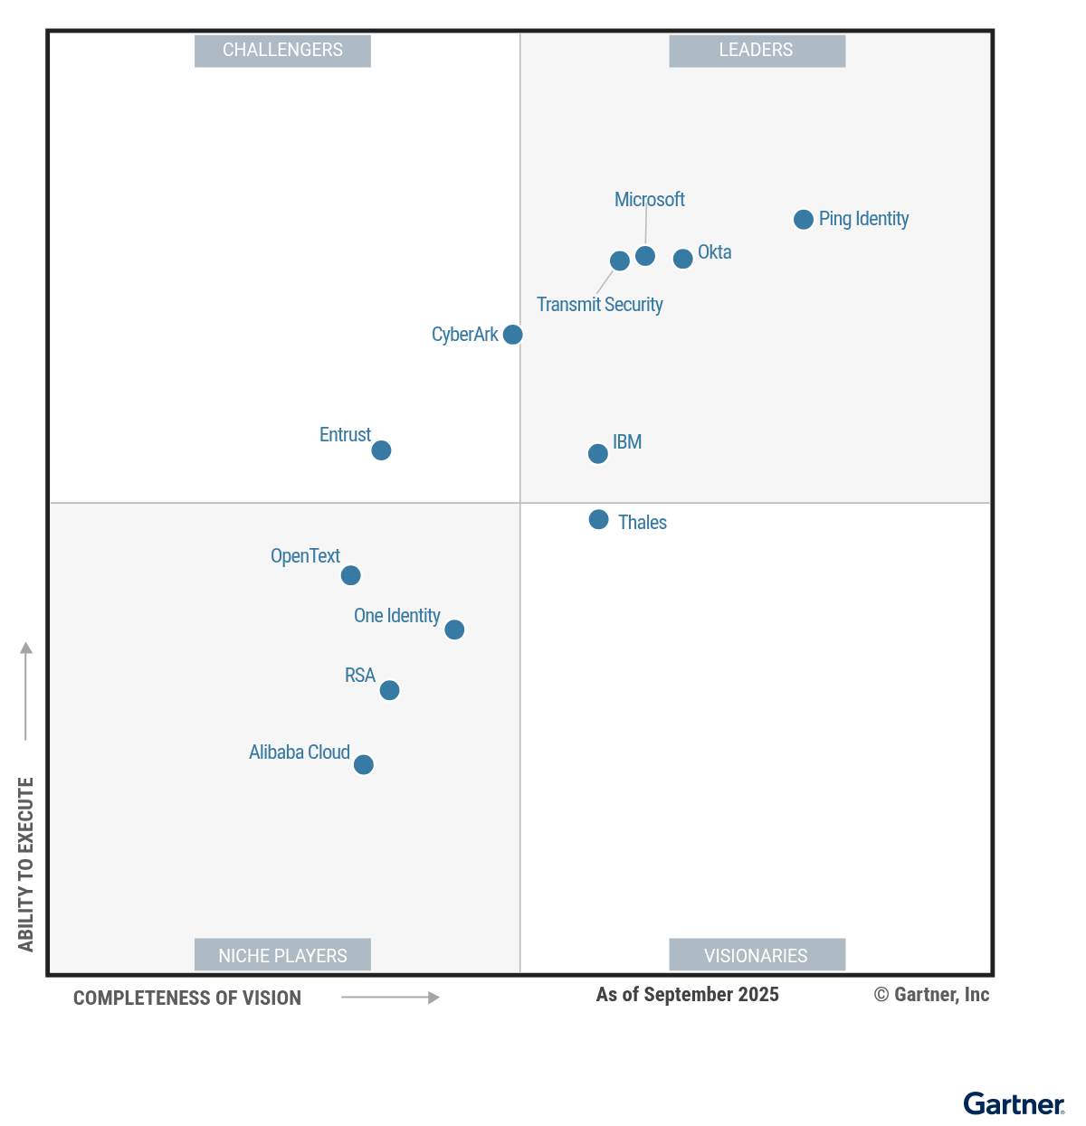
Highest in Execution. Furthest in Vision.
A Leader for 9 years running in the Gartner® Magic Quadrant™ for Access Management.
Gartner does not endorse any vendor, product or service depicted in its research publications and does not advise technology users to select only those vendors with the highest ratings or other designation. Gartner research publications consist of the opinions of Gartner’s research organization and should not be construed as statements of fact. Gartner disclaims all warranties, expressed or implied, with respect to this research, including any warranties of merchantability or fitness for a particular purpose.
GARTNER is a registered trademark and service mark of Gartner and Magic Quadrant is a registered trademark of Gartner, Inc. and/or its affiliates in the U.S. and internationally and are used herein with permission. All rights reserved.
This graphic was published by Gartner, Inc. as part of a larger research document and should be evaluated in the context of the entire document. The Gartner document is available upon request from Ping Identity.
Notes:
We are really excited about the direction of identity and to work with you along this journey whether its customers, workforce, partners, agents, digital credentials, ATO or any of your key challenges.
Please stop by our booth.
Thanks again.

