Slide 1

The Five Habits of Highly Secure Organizations
February 2026
Ben Rothke
Information Security

Slide 2
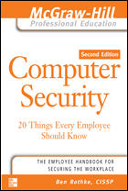
About Me
Senior Manager Information Security Experian*
Author
    Computer Security: 20 Things Every Employee Should Know
    The Definitive Guide to PCI DSS Version 4: Documentation, Compliance, and Management
    RSA Conference book reviews
      https://www.rsaconference.com/experts/ben-rothke
    Articles
      https://medium.com/@brothke
    *Views expressed here are mine exclusively, not my employer’s.

Slide 3
Agenda
Discussion of effective information security habits, characteristics, and practices
Great practices of security-conscious companies
Based on my past experiences at a large spectrum of Fortune 500 and Global 2000 companies

Slide 4

The five habits
CISO
Risk Management
Invests in people, not products
Policies and Procedures
Awareness and Training

Slide 5
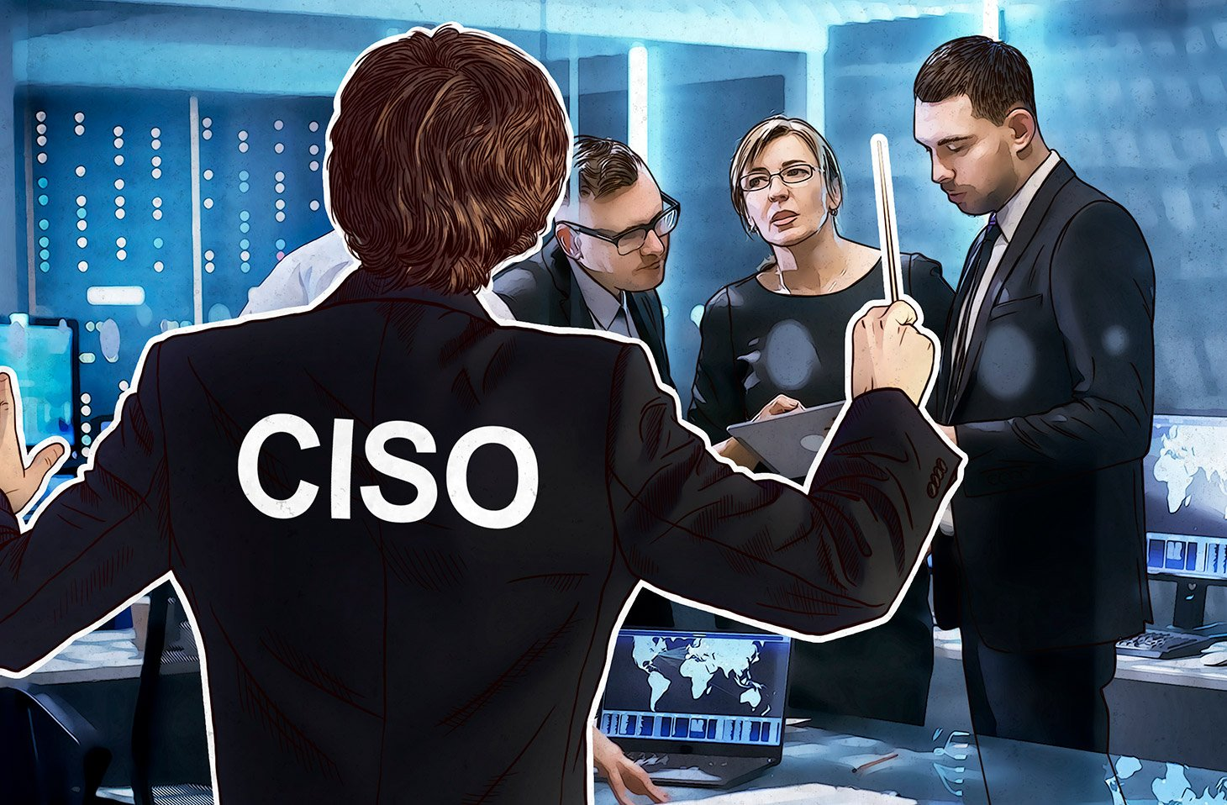
Habit #1 – CISO
Accountants achieve efficiency and effectiveness under the guidance and coordination of a CFO
    Security teams will reach their optimal levels under a CISO
Information security is more than a single technology. It involves:
    physical, psychological, and legal aspects, such as training, encouraging, enforcing, and prosecuting
    strategic planning, skilled negotiating, and practical problem solving
Only an individual with strong business savvy and security knowledge can oversee security planning, implement policies, and select measures appropriate to business requirements - that person is the CISO

Slide 6
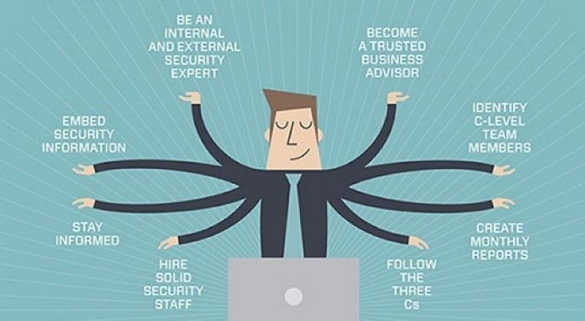
CISO
Characteristics of a great CISO
    Deep understanding of technology, combined with understanding of the organization’s function, politics, and business drivers
    Gold medal CISO - Electrical engineer with an MBA
    Silver medal CISO - NSA veteran with corporate experience
Never a sycophant to the Board of Directors
Invests in people, not technology
    Corollary - vendors intimidated by CISO due to technical prowess
Not intimidated by a screaming SVP trying to force a firewall admin to violate policy
    But is also willing to evaluate the policy to determine whether it is reasonable

Slide 7

CISO
CISO works at the executive level
    Serves on the executive council or equivalent
    Be on the CIO’s architectural strategy council or equivalent
    Direct or dotted-line manager of all information security staff
Without executive-level control, the CISO will face difficulty when bridging the gap between business process demands and security technology requirements
CISO at the non-executive level – expect Spaf’s Law
    “If you have responsibility for security but have no authority to set rules or punish violators, your own role in the organization is to take the blame when something big goes wrong.”
    Prof. Gene Spafford - Purdue University

Slide 8
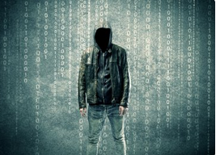
Habit #2 – Risk Management
How management often perceives risk
Risk = evil hacker

Slide 9
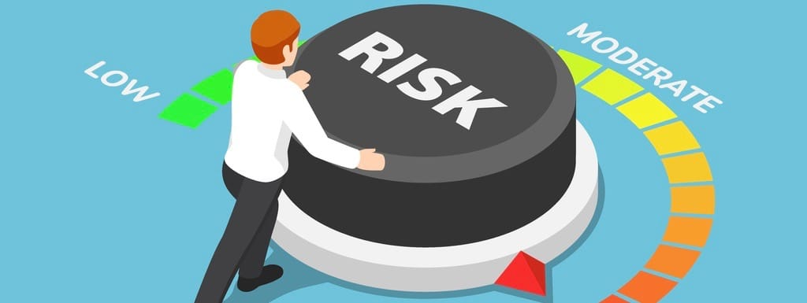
Habit #2 – Risk Management
Comprehensive risk management program must be created around these four areas:
Identification
Analysis
Mitigation
Monitoring

Slide 10
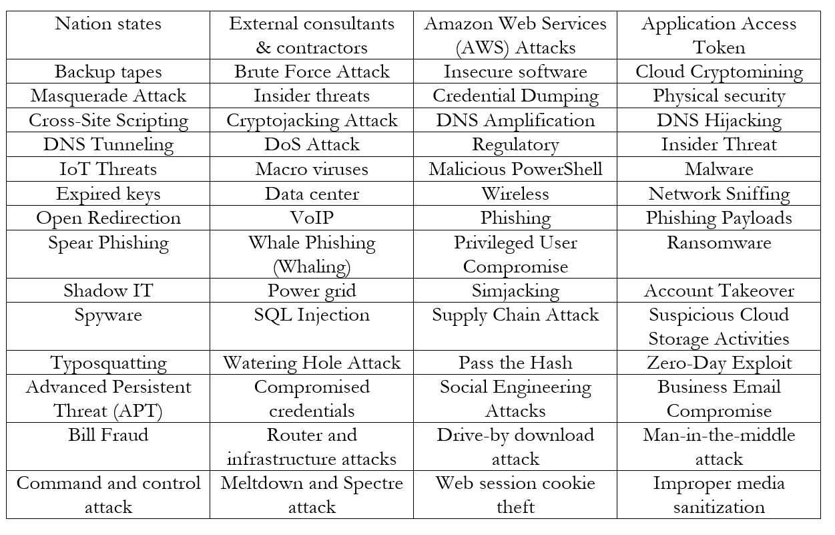
This is risk

Slide 11
Habit #3 – People, not products
People, not products
    A huge mistake companies make is expecting security products to solve their security problems
They buy myriad products without being able to answer:
    What is your security problem, and how do you expect this security product to solve it?
Why are you buying a product?
    Create detailed requirements for its use
      Detailed Design Document (D3) should be required for any significant technology product
    Processes and procedures
    Metrics to measure its effectiveness and value

Slide 12
The big lie of security products
Vendors want you to think their product is the best, but all products are, for the most part, indistinguishable
    By the time a product hits version 3, competition has matched it feature for feature
Observation: most established COTS security products are essentially indistinguishable from each other and can achieve what most organizations require:
    Check Point vs. Cisco
    Wiz vs. Rapid7
Don’t obsess on the products.
Focus on your staff, internal procedures, and specific requirements

Slide 13
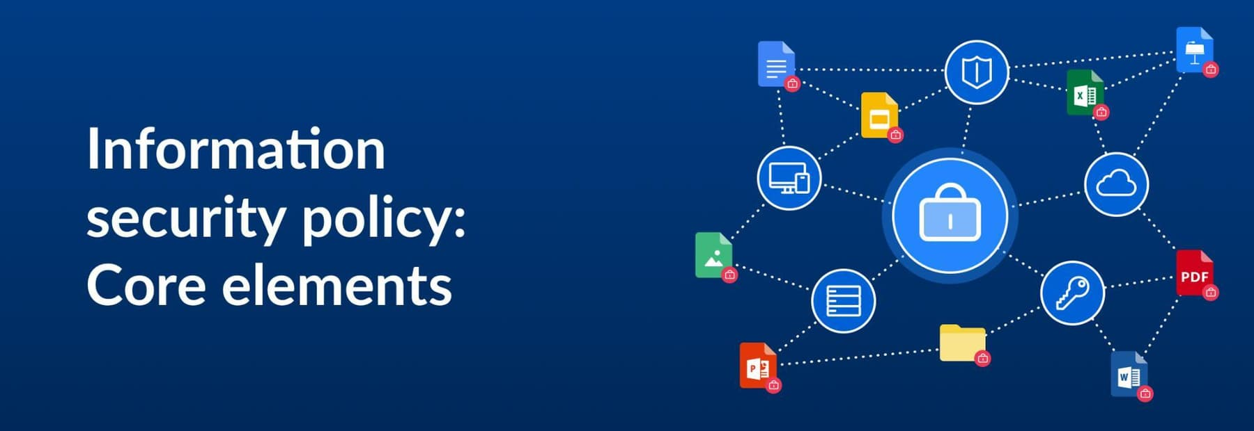
Habit #4 - Policies & Procedures
Comprehensive security policies are required to map abstract security concepts to your real world implementation of your security products
Policy defines the aims and goals of the business
No policies = no information security…. and
No policies enforcement = no information security

Slide 14
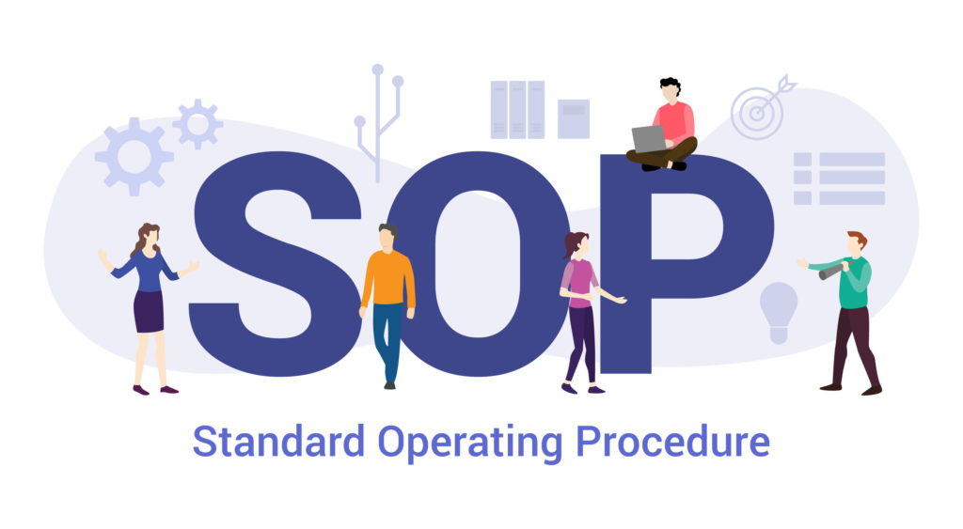
Information security procedures
Standard Operating Procedures (SOP) ensure that the Chicago firewall admin builds & configures corporate firewalls in the same manner as the Tokyo admin
Immense benefits of SOP:
    Standardize operations among divisions and departments
    Reduce confusion
    Designate responsibility
    Improve the accountability of personnel
    Record the performance of all tasks and their results
    Reduce costs
    Reduce liability

Slide 15

Information Security SOP
Information Security SOPs show seriousness
    Organizations that take the time and effort to create infosec SOPs demonstrate their commitment to security
    By creating SOPs, costs are drastically lowered (greater ROI), and the level of security is drastically increased
Aviation industry lives and dies (literally) via its SOPs
    SOPs are built into job requirements and regulations
    Today’s airplanes are far too complex to maintain and operate without SOPs
    Information security might not be as complex as a Boeing 777, but it still requires appropriate SOPs

Slide 16
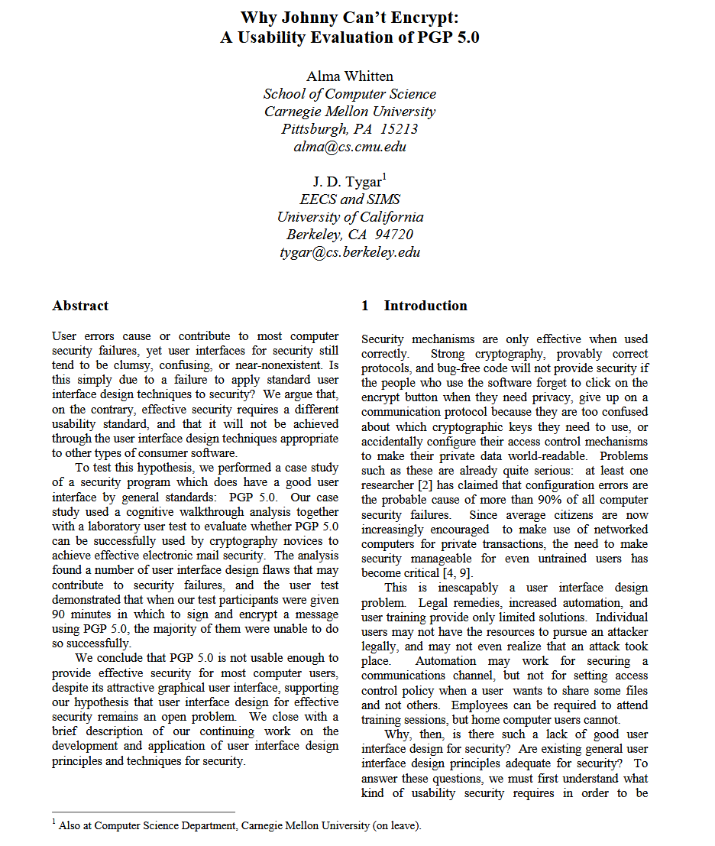
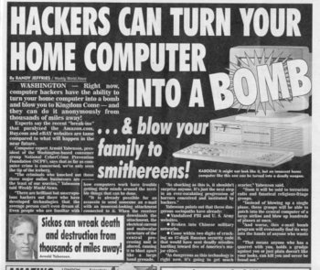

Habit #5 – Awareness & Training
Don’t let TikTok and similar sources be the awareness source
Information security and associated risks aren’t intuitive
    invest in training users to properly use the tools given to them

Slide 17
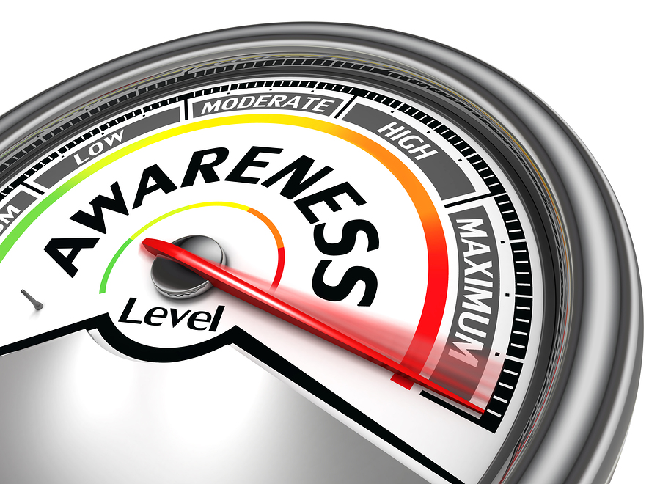
Habit #5 – Awareness & Training
Awareness defines the rules for computer use
Users must be clearly educated as to what acceptable use means
Define exactly what a confidential document is
What is a good password?
What emails should be forwarded?
Can I set up my own wireless network?

Slide 18
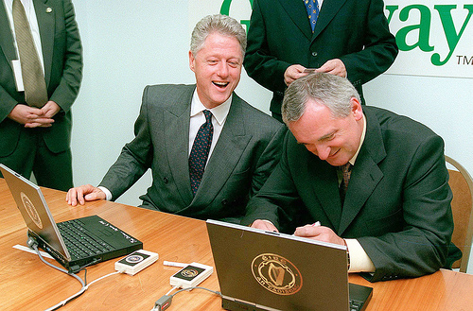
Awareness & Training
Dark moment in computer security awareness
    1998 – US President Bill Clinton and Irish Prime Minister Bertie Ahern used digital signature technology to append their personal signatures to a statement endorsing broad e-commerce policy concerns
    Clinton and Ahern are videotaped entering the passphrase for their private keys
    At the conclusion of the ceremony, they swap the smart cards that contain their private keys
      Video https://www.youtube.com/watch?v=4ddUdEQjrOo / https://bit.ly/4rFiAOz

Slide 19
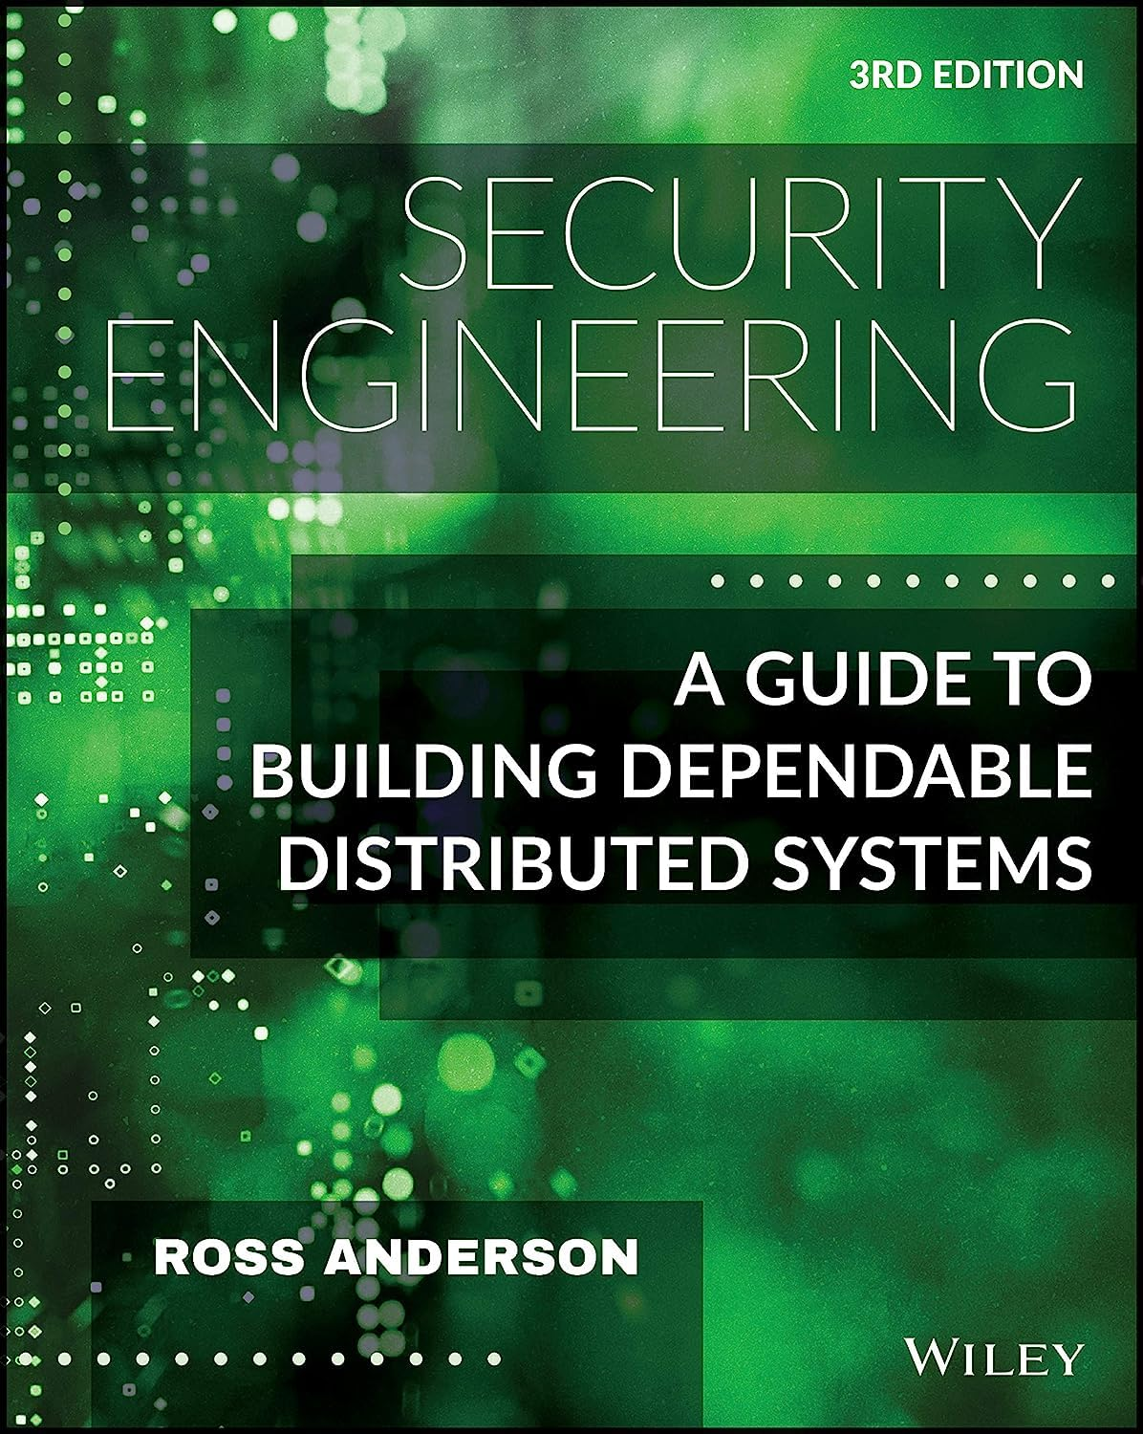




Required reading
Security Engineering: A Guide to Building Dependable Distributed Systems
    https://amzn.to/4ruxGpY
    Free digital version of the 2nd edition http://www.cl.cam.ac.uk/~rja14/book.html
Measuring and Managing Information Risk: A FAIR Approach
    https://amzn.to/4kP12wH
Bruce Schneier
    Crypto-Gram – Schneier’s monthly e-mail newsletter
    http://www.schneier.com/crypto-gram.html
    https://www.amazon.com/stores/Bruce-Schneier/author/B000AP7EVS

Slide 20

Summary
Effective information security takes
    hard work
    leadership
    commitment
    knowledge
    responsibility
    dedication
When implemented in the 5 habits, those are the characteristics of highly secure organizations

Slide 21
Contact info
Ben Rothke, CISSP CISA
Senior Information Security Manager
Experian
www.linkedin.com/in/benrothke
www.twitter.com/benrothke
brothke@gmail.com

